Slide 1
Process in an Operating System
Processes AND Programs

Slide 2
Definition
A process is essentially a running software.
The execution of any process must occur in a specific order.
A process refers to an entity that helps in representing the fundamental unit of work that must be implemented in any system.

Slide 3
Computer programs and processes
We write the computer programs in the form of a text file
When we run them, these turn into processes that complete all of the duties specified in the program.

Slide 4
Components of a Process
A program can be segregated into four pieces when put into memory to become a process:
stack,
heap,
text, and
data.

Slide 5
Components of a Process, con..
Stack
Temporary data like method or function parameters, return address, and local variables are stored in the process stack.
Heap
This is the memory that is dynamically allocated to a process during its execution.

Slide 6
Components of a Process, con…
Text
This comprises the contents present in the processor’s registers as well as the current activity reflected by the value of the program counter.
Data
The global as well as static variables are included in this section.
QN:. What are global and local variables?

Slide 7
Process Life Cycle
When a process runs, it goes through many states.
Different operating systems have diverse stages, and the names of these states are not standardized.
A process can be in one of the following five states:
Start
Ready
Running
wait

Slide 8
Process States
Start
When a process is started/created first, it is in this state.
Ready
Here, the process is waiting for a processor to be assigned to it.
Ready processes are waiting for the operating system to assign them a processor so that they can run.
The process may enter this state after starting or while running, but the scheduler may interrupt it to assign the CPU to another process.

Slide 9
Process States, cont…/
Running
When the OS scheduler assigns a processor to a process, the process state gets set to running
The processor then executes the process instructions one by one.
Waiting
If a process needs to wait for any resource, such as for user input or for a file to become available, it enters the waiting state.

Slide 10
Process States, cont…/
Terminated or Exit
The process is relocated to the terminated state, where it waits for removal from the main memory.
This is done once it has completed its execution or been terminated by the operating system.

Slide 11
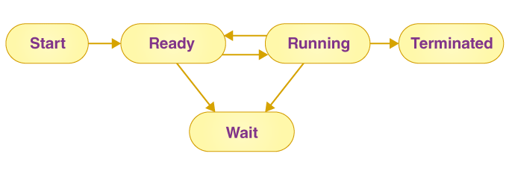
Process States

Slide 12
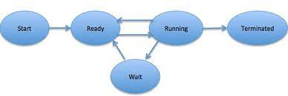

Slide 13
Process Control Block (PCB)
Every process has a process control block, which is a data structure managed by the operating system.
An integer process ID (or PID) is used to identify the PCB.
PCB stores all of the information required to maintain track of a process.

Slide 14
Components of a PCB
Process state
The process’s present state, such as whether it’s ready, waiting, running, or whatever.
Process privileges
This is required in order to grant or deny access to system resources.
Process ID
Each process in the OS has its own unique identifier.

Slide 15
Components of a PCB, cont../
Pointer
It refers to a pointer that points to the parent process.
Program counter
The program counter refers to a pointer that points to the address of the process’s next instruction.
CPU registers
Processes must be stored in various CPU registers for execution in the running state.

Slide 16
Components of a PCB, cont../
CPU scheduling information
Process priority and additional scheduling information are required for the process to be scheduled.
Memory management information
This includes information from the page table, memory limitations, and segment table
All these are dependent on the amount of memory used by the OS.

Slide 17
Accounting information
This comprises CPU use for process execution, time constraints, and execution ID, among other things.

Slide 18
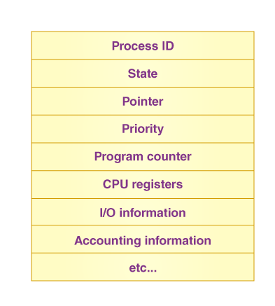
Components of a PCB

Slide 19
Reading Assignment
Read About and summarize the following sub topics
Hardware features
Interrupts

Slide 20
Interrupts
An interrupt is a signal emitted by a device attached to a computer or from a program within the computer.
It requires the operating system (OS) to stop and figure out what to do next.
An interrupt temporarily stops or terminates a service or a current process.
Most I/O devices have a bus control line called Interrupt Service Routine (ISR) for this purpose.

Slide 21
Interrupt occurrence
An interrupt signal might be planned (i.e., specifically requested by a program) or
it may be unplanned (i.e., caused by an event that may not be related to a program that's currently running on the system).
In modern days, almost all computing systems are interrupt-drive.
They follow the list of computer instructions in a program and run the instructions until they get to the end or until they sense an interrupt signal

Slide 22
questions
Why do we need interrupts in Operating systems
What are the disadvantages of interrupts
What are the types of interrupts

Slide 23
The end
Thank you for your attention

